Slide 1
Monitor
Microsoft Power Platform
Govern
&
Grow
1. Secure
2. Monitor
3. Alert and Action
4. Deploy
5. Nurture
6. Infrastructure
7. Support

Slide 2
Monitor: What we plan to cover
1. Secure
2. Monitor
3. Alert and Action
4. Deploy
Product discovery: understand the origin of apps & flows | Review out-of-box analytics | Leverage management connectors & PowerShell to automate your policies | Understand managed vs unmanaged solutions
Know your environments | Configure audit logs | Welcome new makers and foster best practices | Learn the Application Lifecycle Management (ALM) toolset and best practices
Learn the 5 layers of security + the one that maters most | Leverage management connectors & PowerShell as powerful reporting tools | Identify and empower champions
Setup data loss prevention policies

Slide 3
Now let’s monitor
1. Secure
2. Monitor
3. Alert and Action
4. Deploy

Slide 4

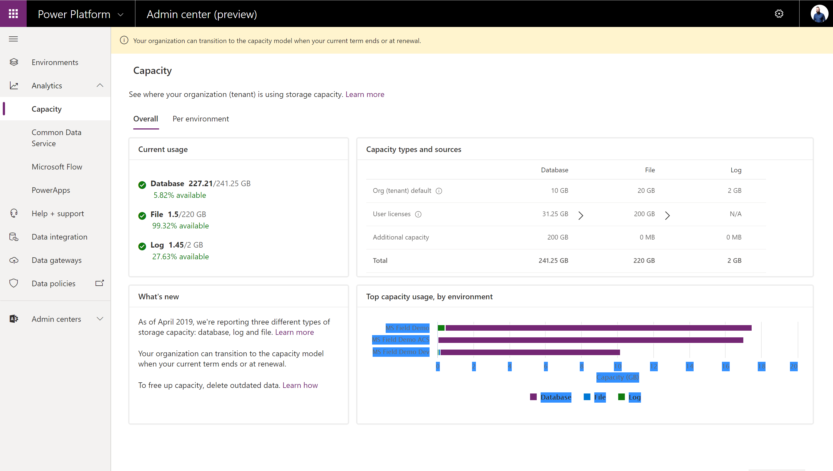
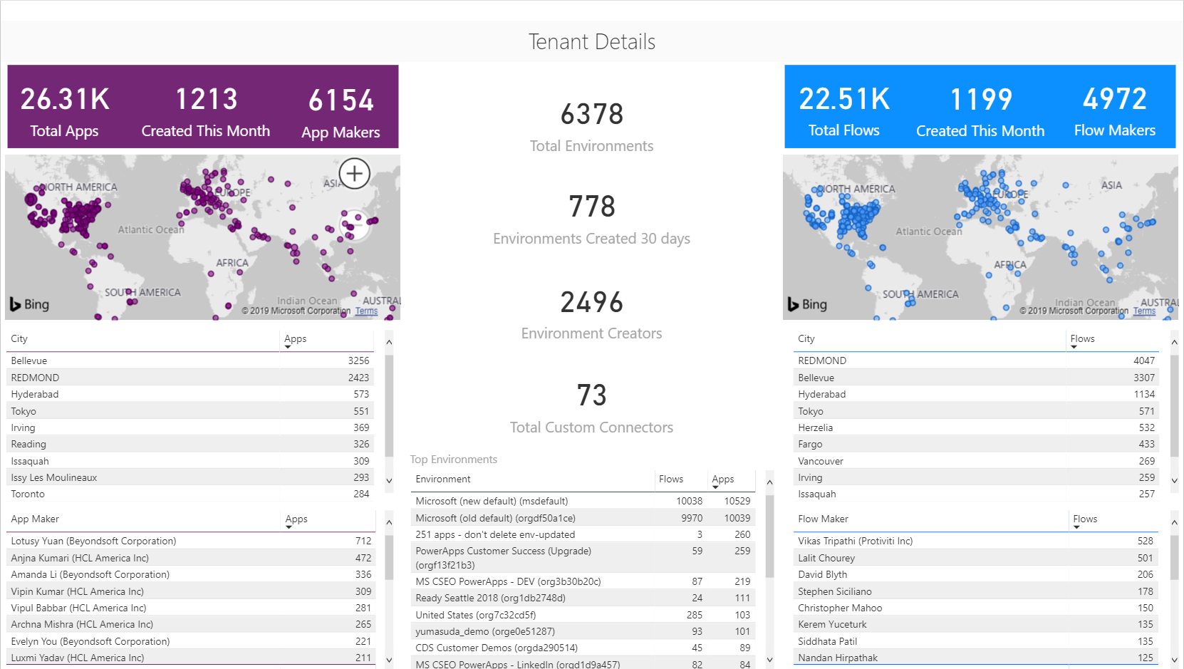
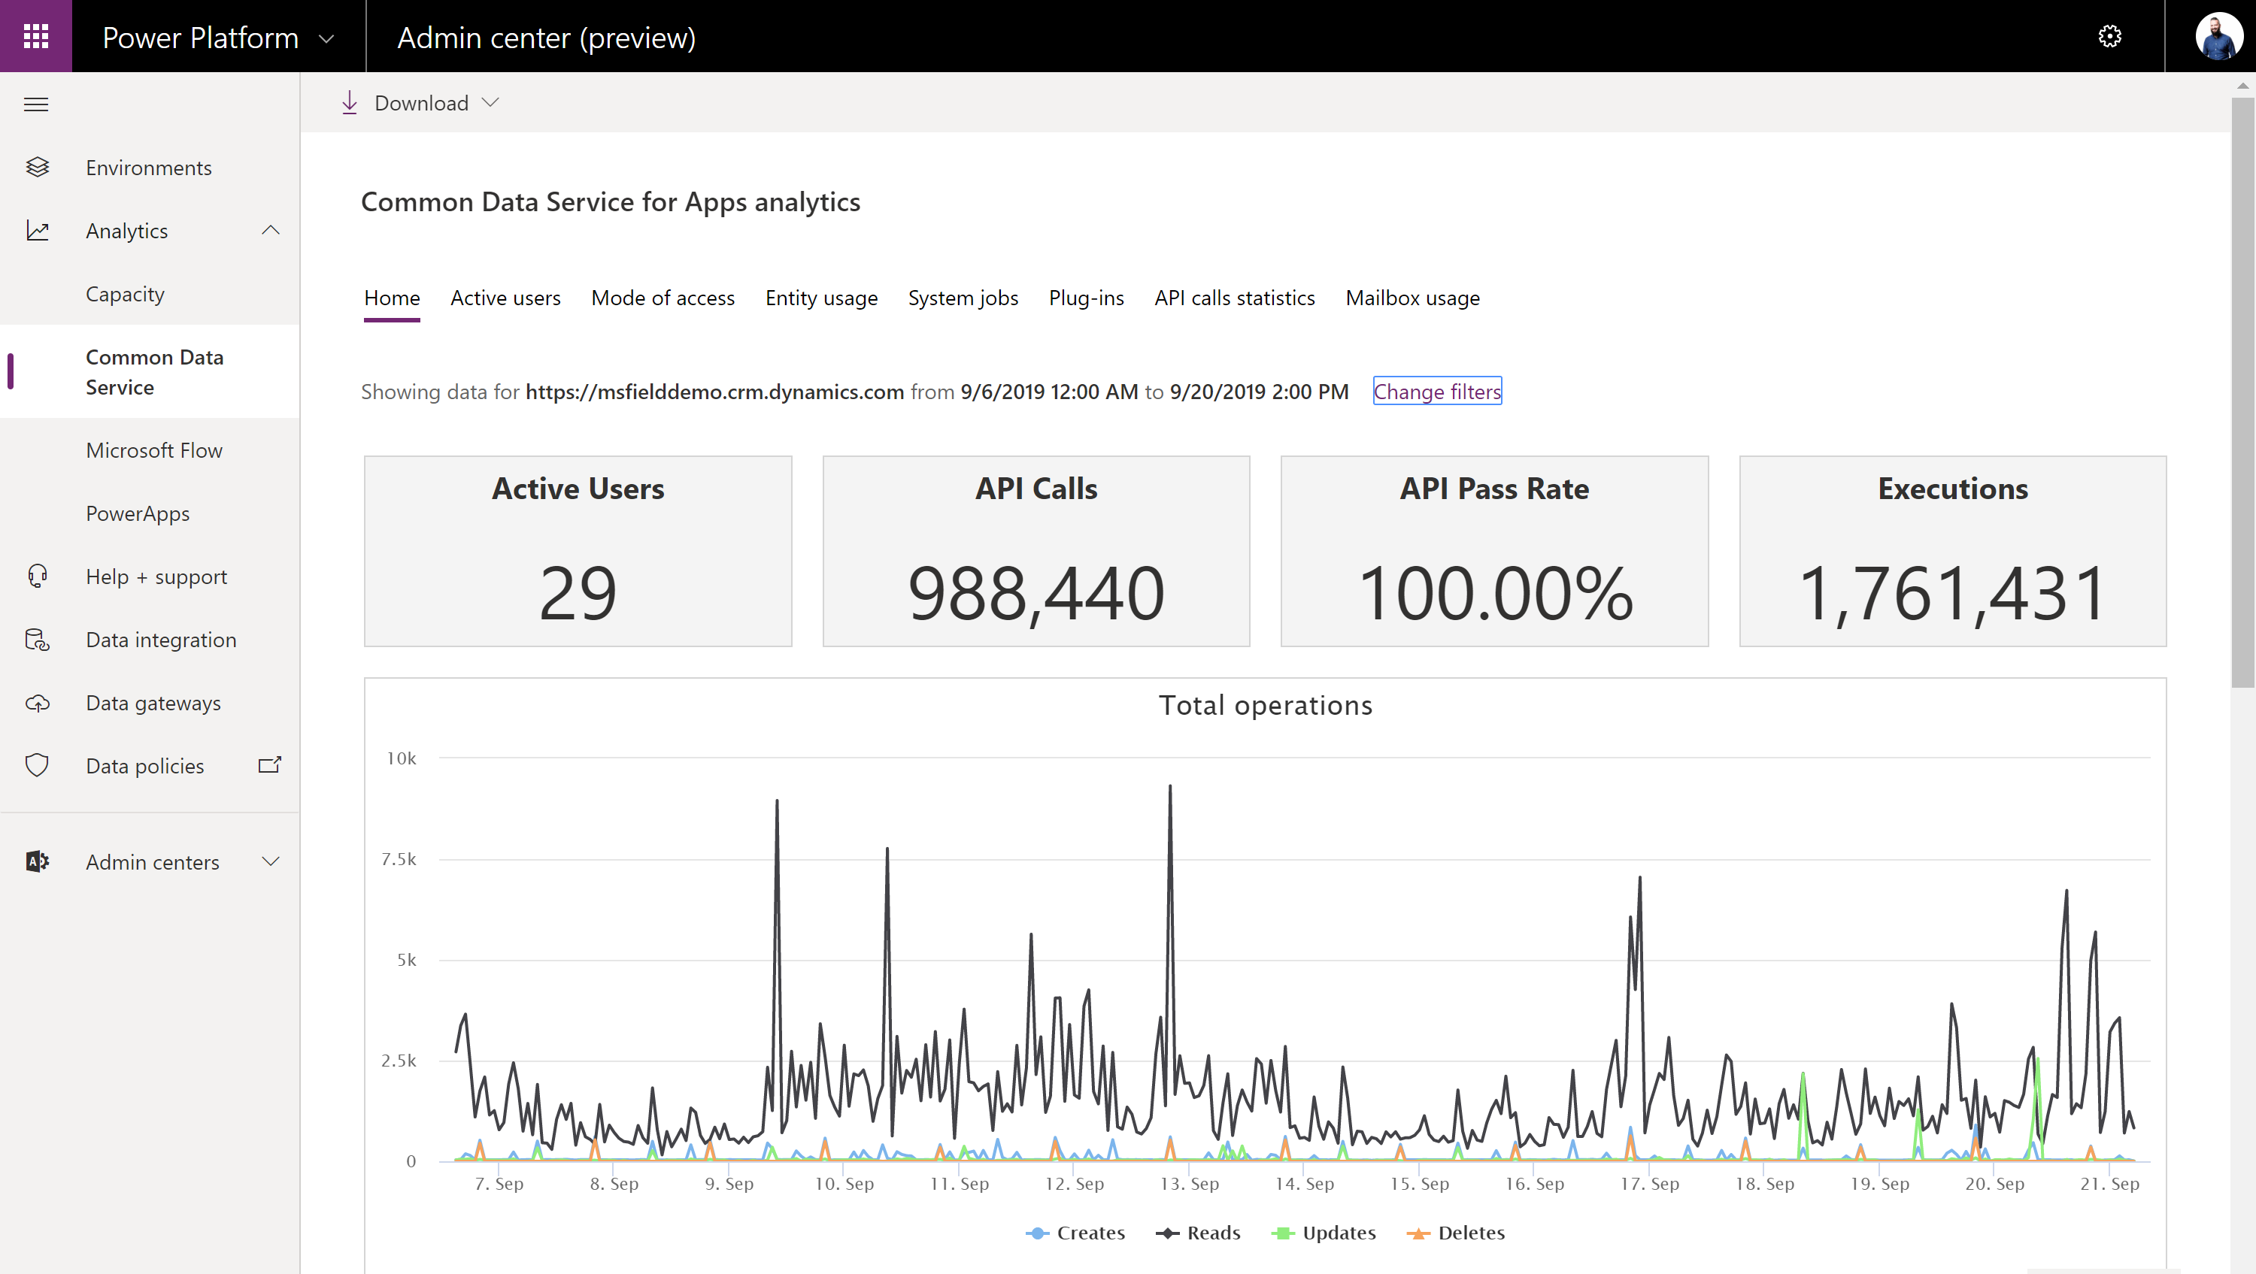
Admin reporting and analytics in the Power Platform admin center
Admin insights provide deep visibility into usage and performance of applications
Users
Locations
Capacity
Personalize insights and drive action with custom Power BI reports and Power Automate
All up view of what’s being created
Discover your champions
Trigger automated actions
Analytics track health and implementation metrics and help keep users on track
Service performance
Error reporting
App usage

Slide 5

Logs & analytics – see what’s happening
Power Apps and Power Automate logs available at https://protection.office.com/
Activity Logging integrated with Office Security and Compliance center for comprehensive logging across Microsoft services.
The audit records are stored in Office 365 Security and Compliance center. Must have an Office 365 E3 or greater license Must enabled at the organization level
Office provides an API to query this data, which is currently used by many SIEM vendors to use the Activity Logging data for reporting
Power Automate | Power Apps
Created flow Edited flow Deleted flow Edited permissions Deleted permissions Started a paid trial Renewed a paid trial | Created app Edited/save app (draft) Published app Deleted app Restored an app from app version Launched app Marking app as featured Marking app as hero Edited app permissions Deleted app permissions
Notes:
CDS is focused on database and model-driven app user activity
Power Apps is targeted toward canvas app
The data is stored only in the region that an environment is hosted in.

Slide 6
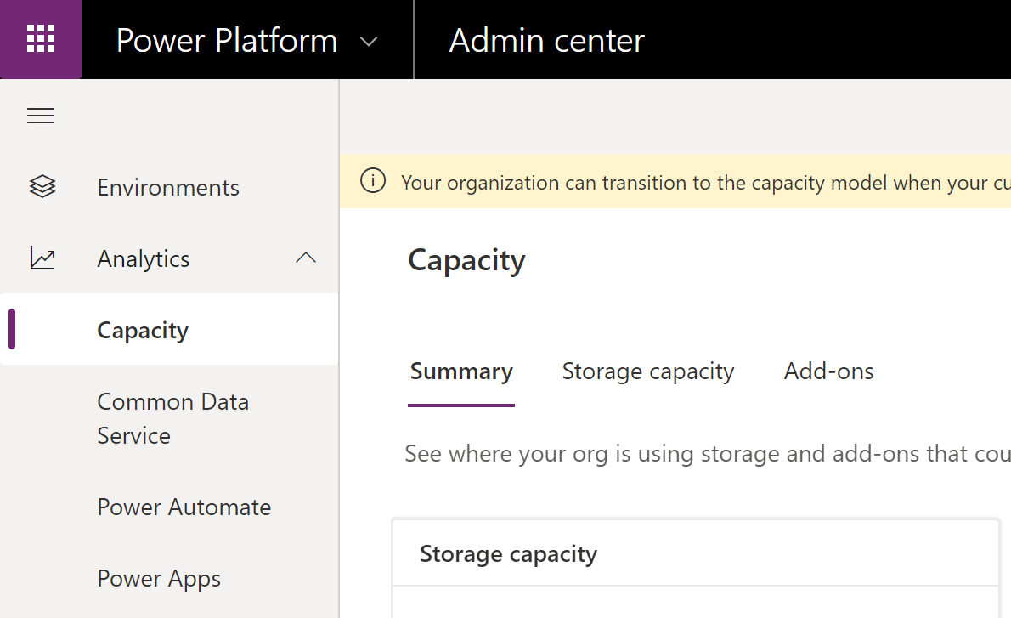
Logs & analytics – see what’s happening
Admin analytics Tenant and environment level analytics Available from Power Platform admin center aka.ms/ppac Access is available for environment admins Data is stored for 28 days Data is refreshed daily
Maker analytics Canvas app and flow level analytics Available from make.powerapps.com and flow.microsoft.com Access is available to app & flow owners (admins can grant themselves access) Data is stored for 30 days Data is refreshed daily
Notes:
CDS is focused on database and model-driven app user activity
Power Apps is targeted toward canvas app
The data is stored only in the region that an environment is hosted in.

Slide 7
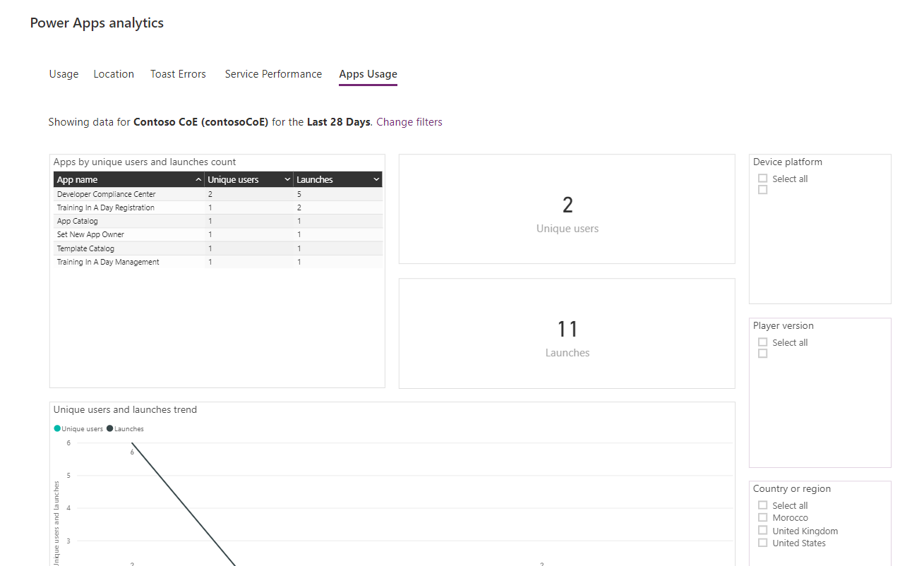
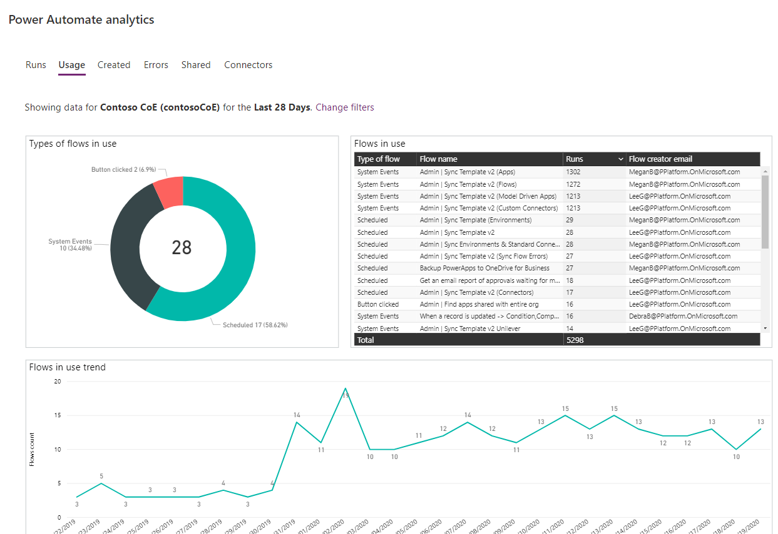
Logs & analytics – see what’s happening

Slide 8
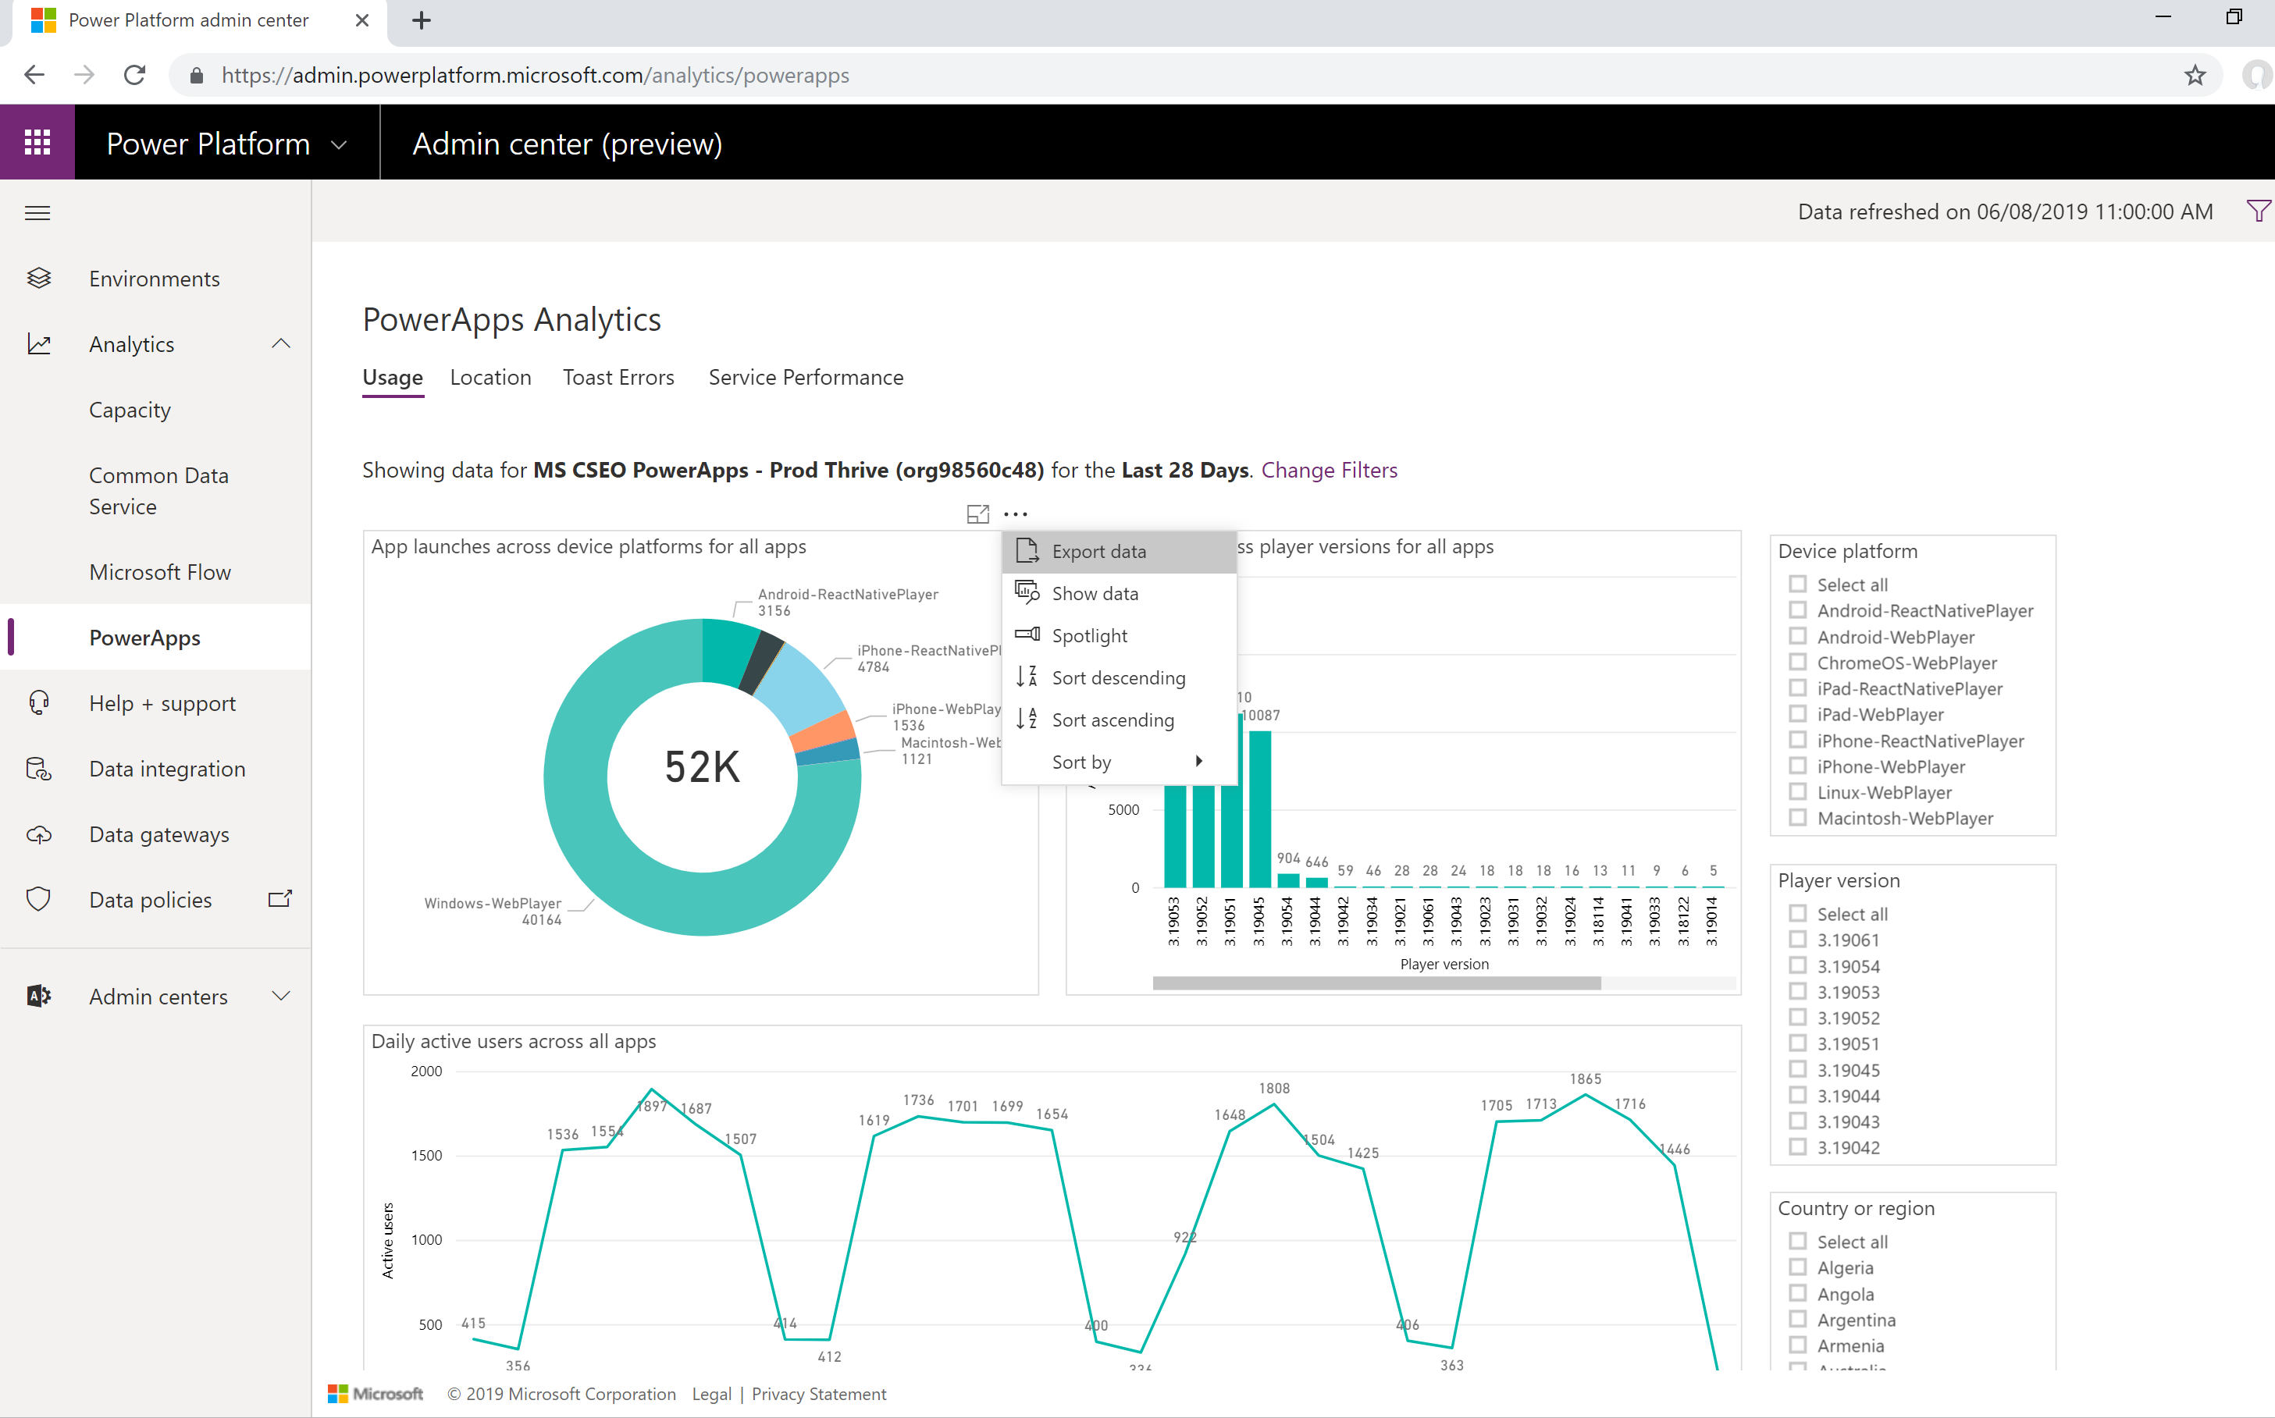
Downloading analytic data

Slide 9
Center of Excellence Toolkit
Best
Practice
#4
Download here now https://aka.ms/COEStarterKit
Step | Scenario | Toolkit Component
Secure​ | DLP Editor | DLP Editor​ (Canvas App) DLP Customizer (Canvas App)
Monitor​ | Power Automate templates to collect data into CDS​ Power BI Dashboards​ | CDS Entities​: Environments, Apps, Flows… Flow - Sync resources template​ Flow - Sync audit logs Power BI Dashboard Custom Connector for Office 365 Audit Logs Power Platform Admin View (Model Driven App)
Alert & Action​ | App Audit example process Set new app owners Act based on specific connectors Archive unused apps | Developer Compliance Center​ (Canvas App) Compliance detail request​ (Flow) Developer Compliance Center (Canvas App) Flow – Compliance detail request Business Process Flow for Auditing resources App Catalog (Canvas App) Set New App Owner (Canvas App) App Archive and Clean Up (Flow) Find Flows and Apps that use specific connectors (Flow)
Nurture​ | Encourage Adoption Provide best practises Welcome email, Internal community channel links​ | Welcome Email (Flow) Training in a Day Management (2 Canvas Apps Training in a Day Notifications (Flow) Newsletter with Product Updates (Flow) Template Catalog (Canvas App)

Slide 10
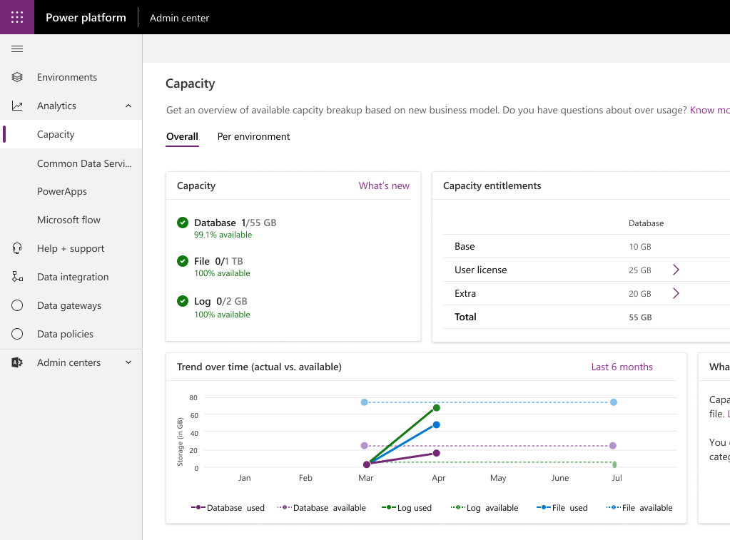
Monitoring Capacity & Why is it important?
Monitoring storage capacity report Storage capacity entitlements and usage for database, file and log capacity
Create additional environments
When 1GB of database capacity available
No separate license for prod/non-prod envs
Coming summer 2019
Increased storage File/Log capacity frees up database capacity 4TB size limit does not apply to File/Log capacity
Report sample—for illustration only
Notes:
Create additional instances
New instances can be created if 1 GB of database capacity is available at a minimum as the new environment will consume 1 GB.
New storage capacity report
New storage capacity report will be available in the Power Platform Admin center. It will outline entitlements and usage for database, file and log capacity.
Increased storage
Organizations will get additional storage allocations (default/user) for file and log capacity. As File and audit logs are removed from the database capacity, storage frees up. The db size limitations do not apply to file/log capacity.
Transition to new platform capacity
Customers do not need to take action. Existing APIs are backwards compatible.

Slide 11
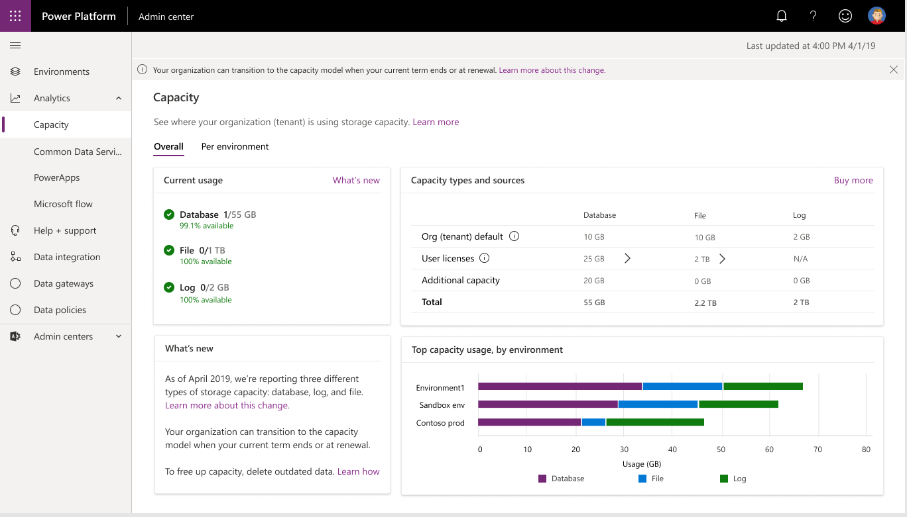
New Capacity report

Slide 12
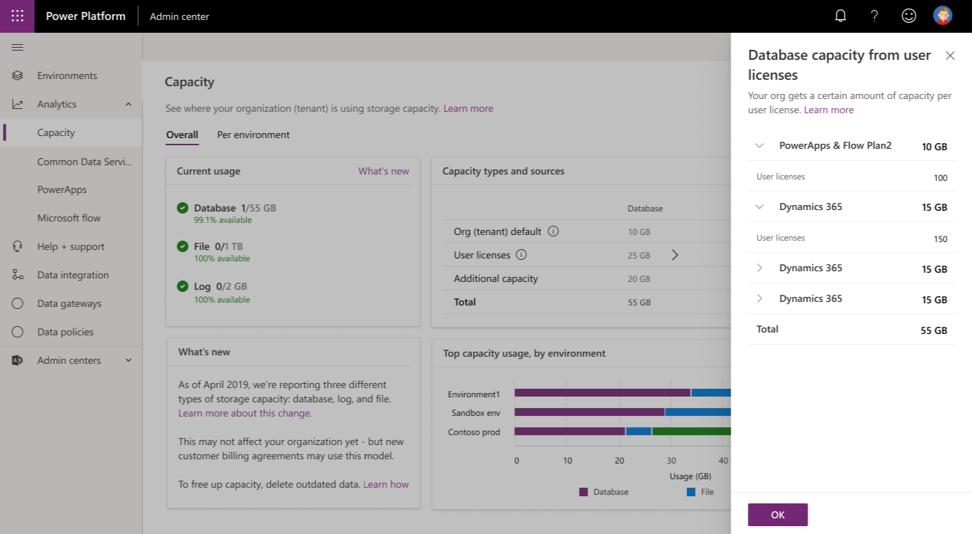
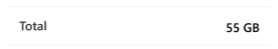
Database capacity entitlements
25 GB

Slide 13
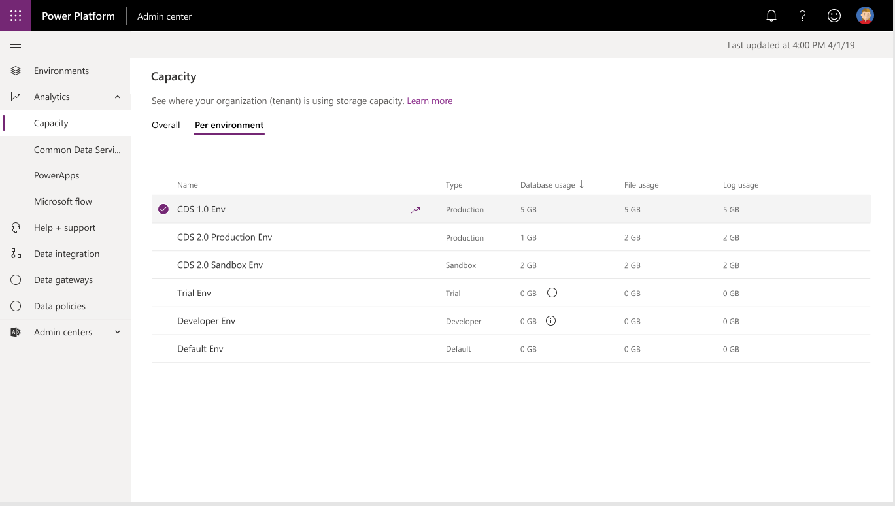
Database capacity entitlements

Slide 14
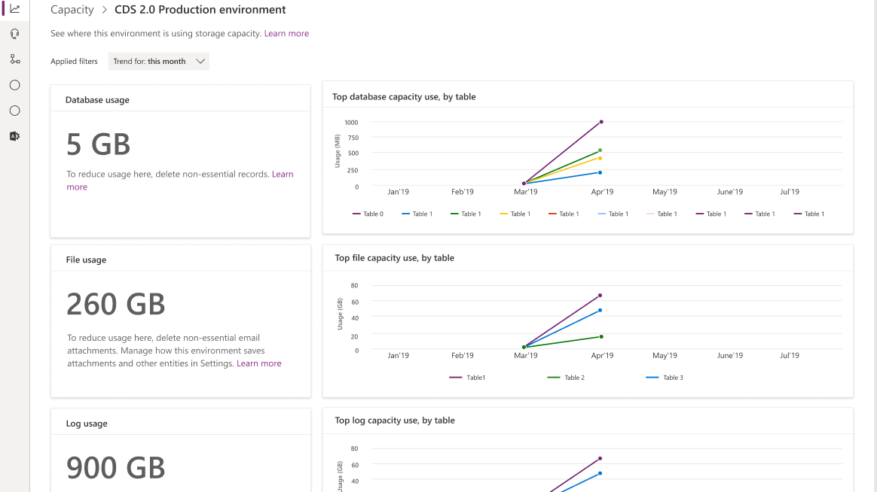
Database capacity entitlements

Slide 15
Power Apps Admin Analytics (Canvas Apps)
Adoption
Usage
Health
Active User
How many users are using the app
Daily active usage
Location
Where is the usage of apps
Drill down by country
App usage
App launches across device platform
App launches across player version
Service Performance
Best performing service
Least performing service
Service response time
And more
Error reporting
Apps by toast error count
Toast error trend
Error breakdown by httpstatus
Notes:
In addition to makers, we will be launching preview for admin analytics in a weeks time.

Slide 16
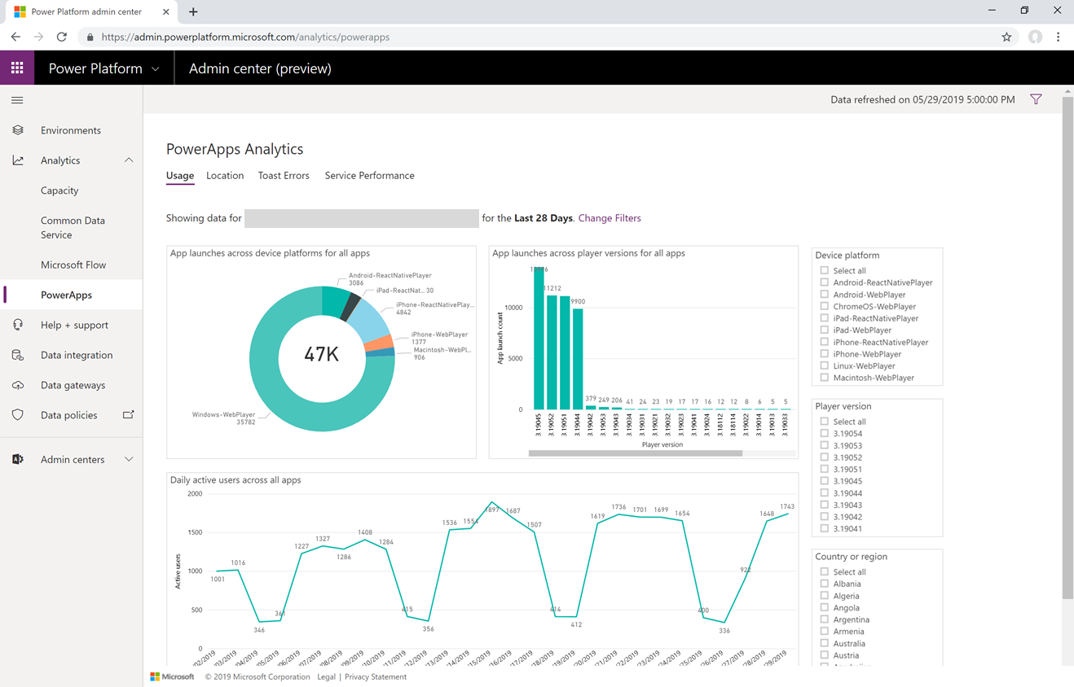
Notes:
Usage can provide insight into how much the app is used and when. Additional analytics can be found in the maker portal if the app is shared with you
Location can give insight into where the app is used from
Toast errors can give insight into errors users might be seeing. If users report problems with an app but don’t have specifics that is a good place to look to see if there are any errors occurring
Service performance gives insights into the performance of each connector - for example users reporting the app is slow – check here to see the performance of each connector the app uses and look for one with high average times

Slide 17
Common Data Service Admin Analytics
Adoption
Usage
Health
System jobs analysis
Pass rate
Throughput
Top failures
Backlog
Plug-in analysis
Pass rate
Execution time
Top failures
API calls analysis
Pass rate
Most used Api’s
Top failures
#of Active users
Active user trends
Top active users
Mode of access
By OS
Device type
Browser
And more
Most used out of the box entities
Most used custom entities
Activities performed (CRUD)
System jobs, Plug-in’s and API call usage
Notes:
Environment Admin data will be stored in the respective environment regions only. Tenant admin data will be separately stored in the tenant home country.
By Q4 –
Connectors - Which part of the business are my flows being used.
(including approvals)?
Publishers – of flow across tenant and environment
Process Duration – Performance of flows and impact on process

Slide 18
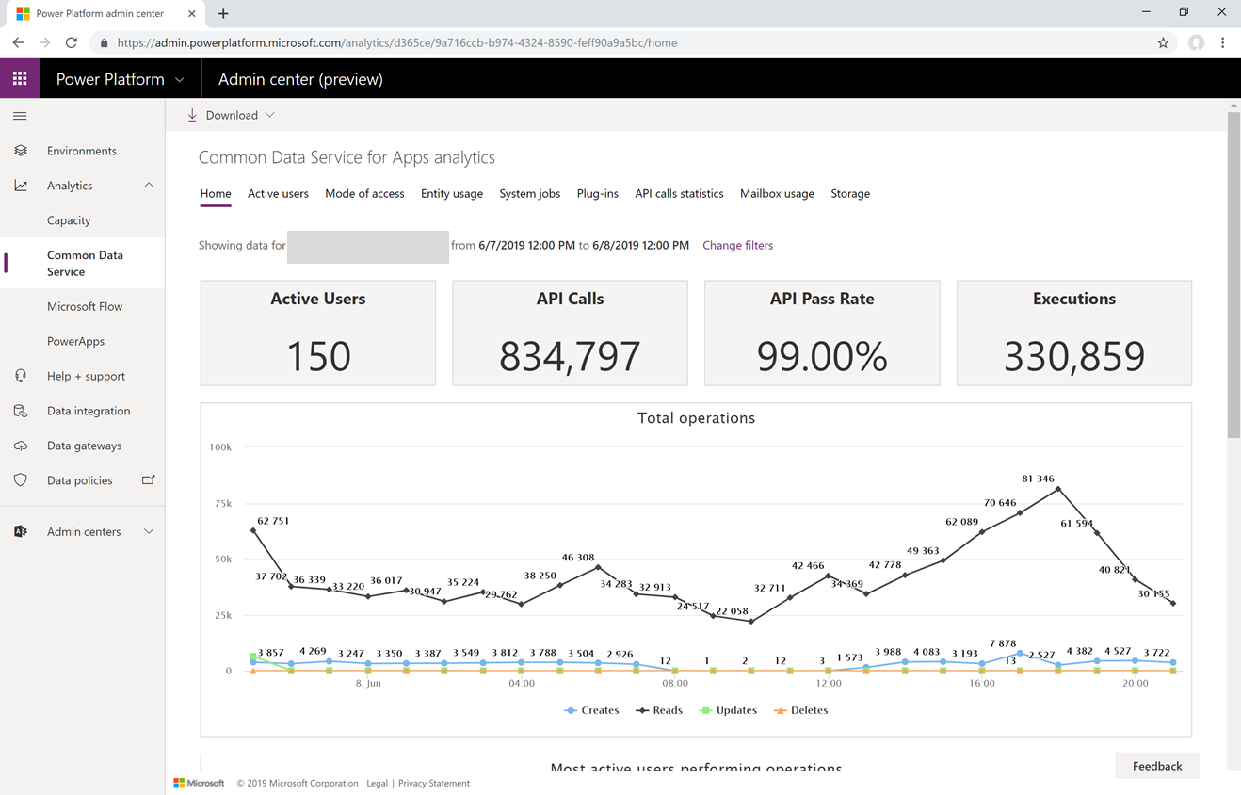
Notes:
Usage can provide insight into how much the app is used and when. Additional analytics can be found in the maker portal if the app is shared with you
Location can give insight into where the app is used from
Toast errors can give insight into errors users might be seeing. If users report problems with an app but don’t have specifics that is a good place to look to see if there are any errors occurring
Service performance gives insights into the performance of each connector - for example users reporting the app is slow – check here to see the performance of each connector the app uses and look for one with high average times

Slide 19
Power Automate Environment Admin Analytics
Adoption
Usage
Health
Total number of errors
Split by error type
Errors across flows
List of errors by flow name
PowerBI capabilities to drill down
Types of flows created
Button click
Scheduled
System events
Flow creation trends
Created flow list view
Run metrics - Active runs, success and failure
Flows in use
Flows in use trend
Shared flows and types, flow names, # of shares
Connectors by runs, # connections, flows involved and drill down on flows
Notes:
Environment Admin data will be stored in the respective environment regions only. Tenant admin data will be separately stored in the tenant home country.
By Q4 –
Connectors - Which part of the business are my flows being used.
(including approvals)?
Publishers – of flow across tenant and environment
Process Duration – Performance of flows and impact on process

Slide 20
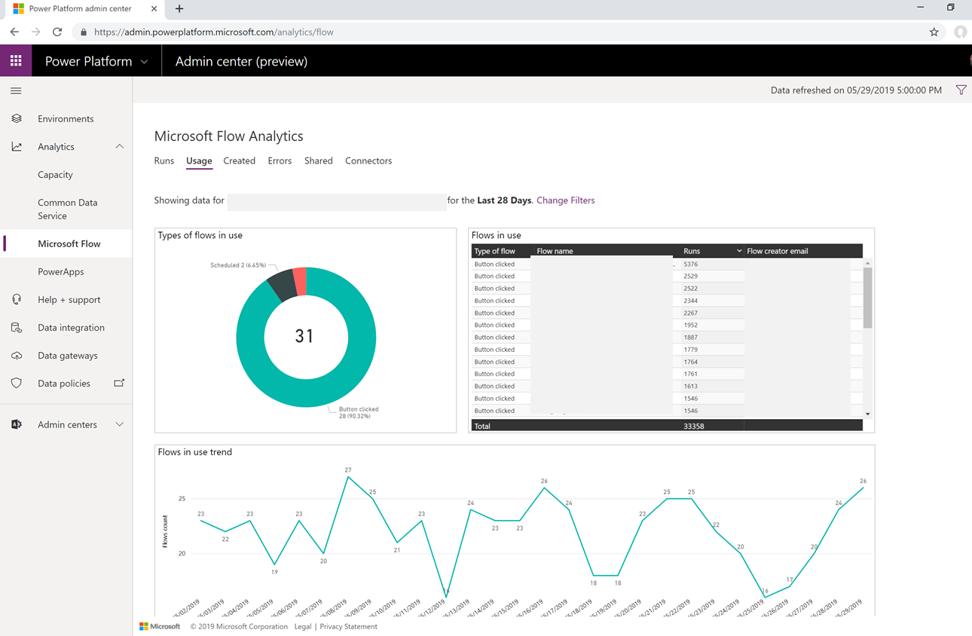
Notes:
Usage provides insights related to the types of flows that are in use. This includes Button, Scheduled and System Event flows, all broken down by the number of runs and the trend over a configured timeline.
Created provides insight into the different types of flows that have been created. This includes Button, Scheduled and System Event flows, all broken down by the number of runs and a trend over a configured timeline.
Errors provides insights into flows that may be experiencing issues. The errors will be broken down by error type so that you can look for common problems that may exist. This can kick off the discussion with the maker so they can look at the detail for the flow.
Shared provides insight into the flows that have been shared within an environment. Include information will be the type of flow including Button, Scheduled or System Events.

Slide 21
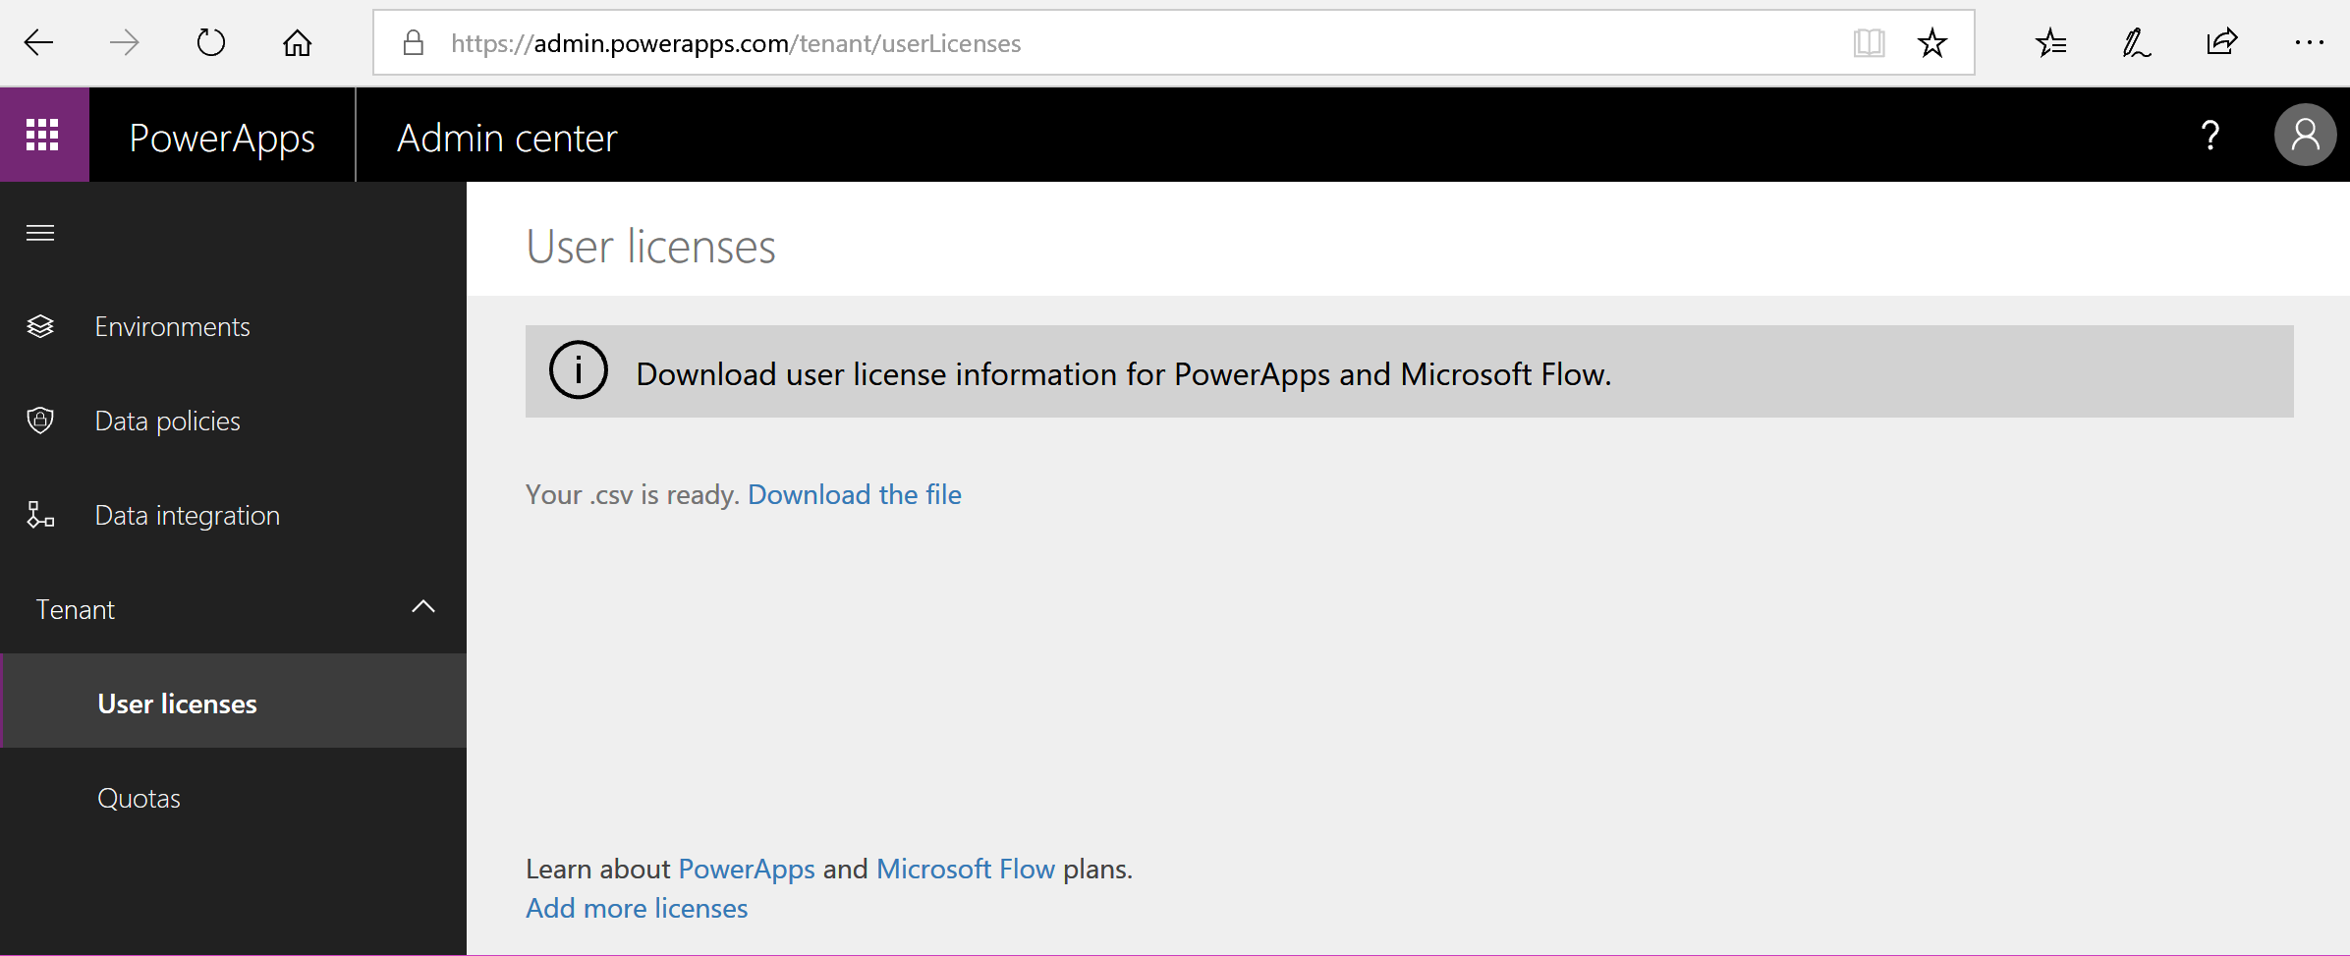
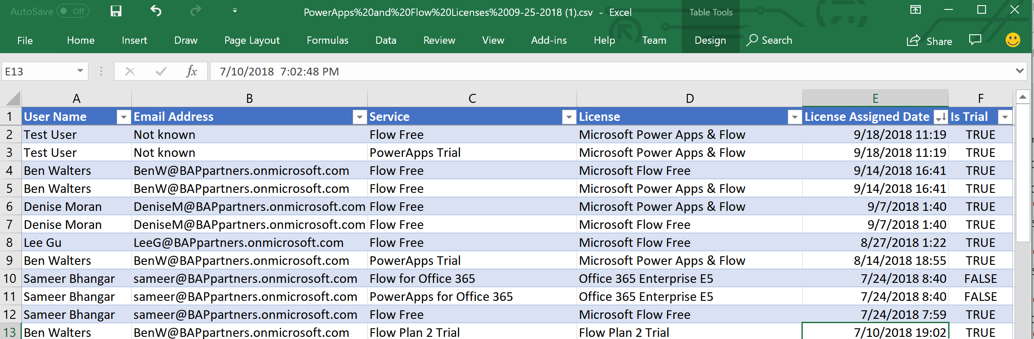
Download the Power Apps & Power Automate license report

Slide 22
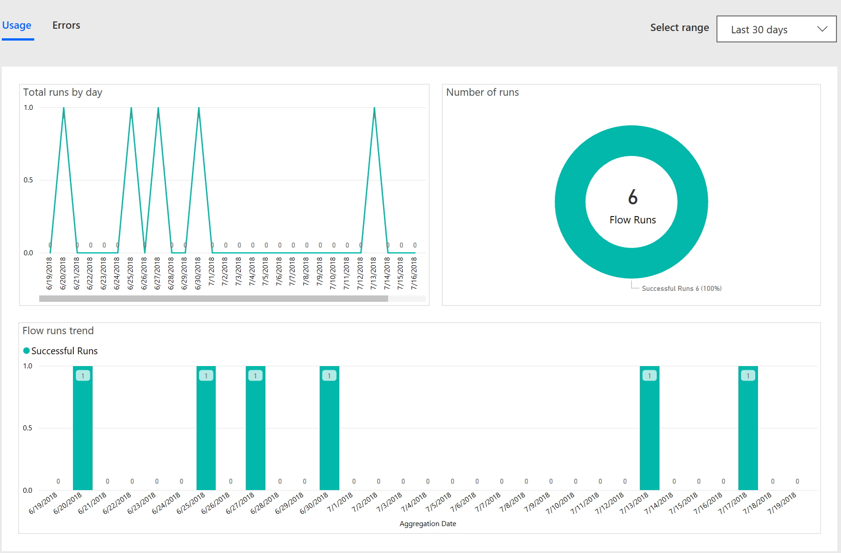
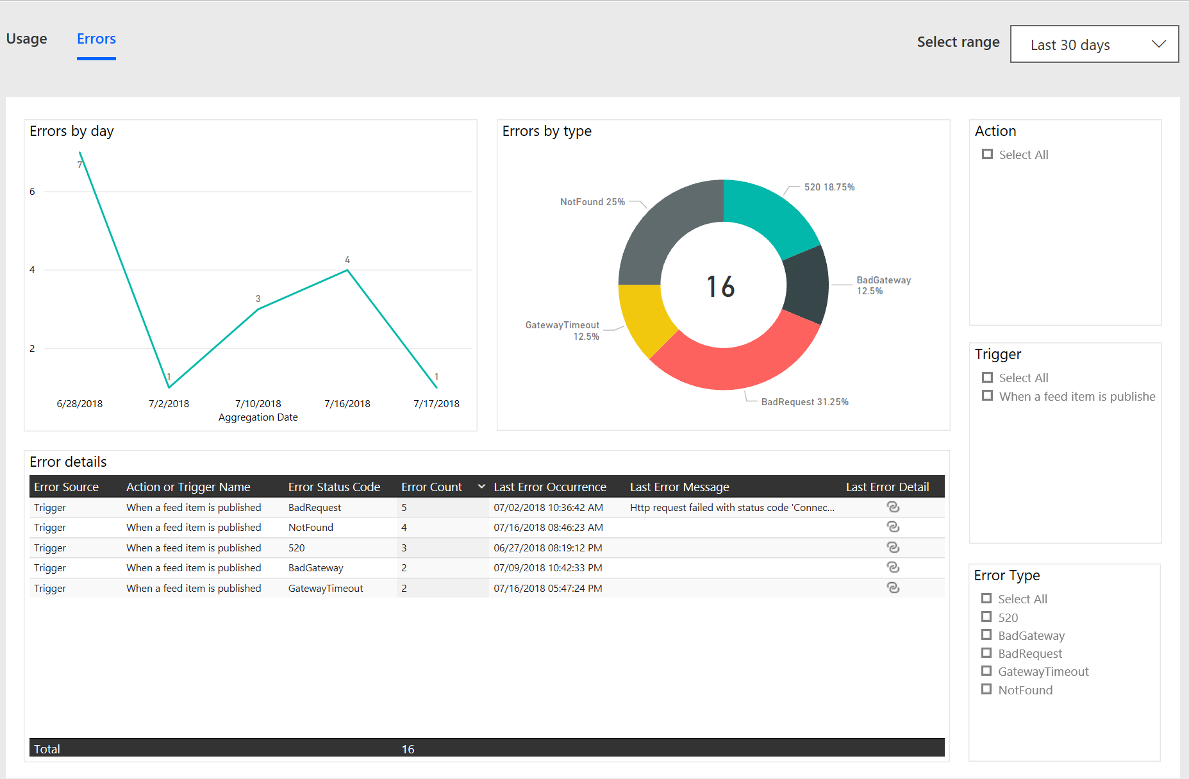
Maker Analytics: Power Automate
Power Automate maker reports
Usage (total flow runs by day, number of runs, trends) – helpful for monitoring Microsoft Flow consumption
Errors (by day, error types, error details) – helpful for troubleshooting Microsoft Flows running in your environment.
Notes:
By dec/jan 2018 - what are the connections in use for my flows; and data for approvals.

Slide 23
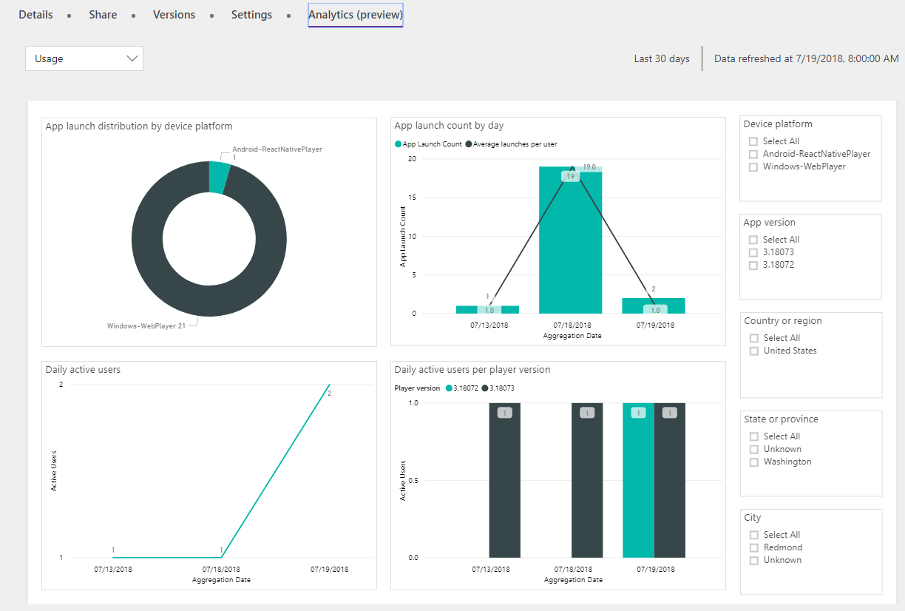
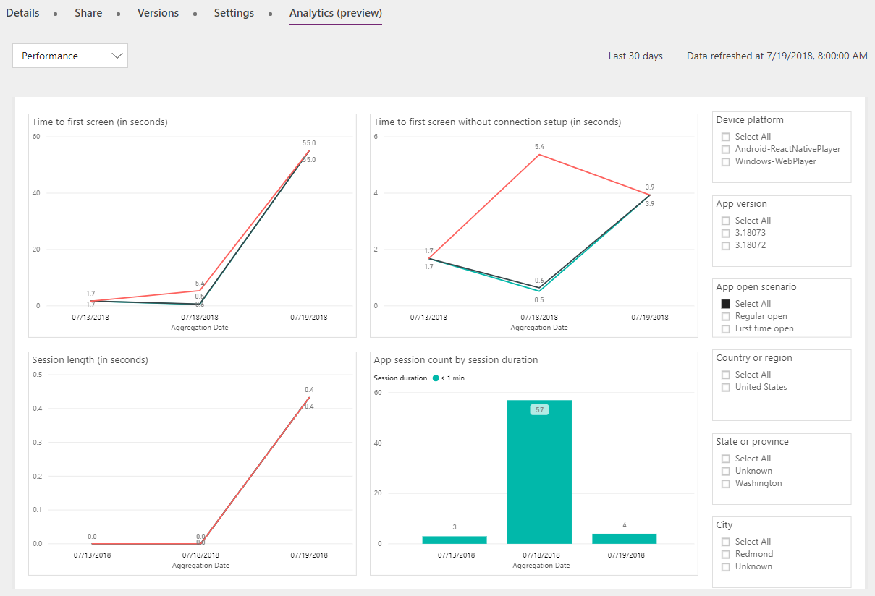
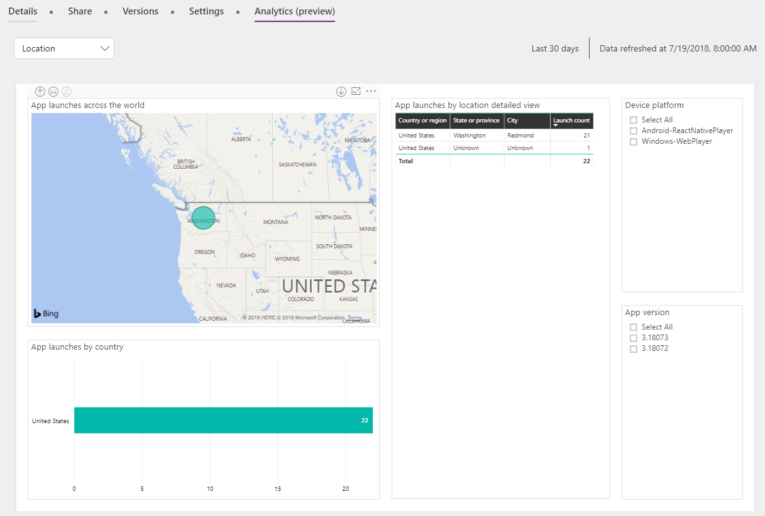
Maker Analytics: Power Apps
Power Automate maker reports
Usage (total flow runs by day, number of runs, trends) – helpful for monitoring Microsoft Flow consumption
Errors (by day, error types, error details) – helpful for troubleshooting Power Automate flows running in your environment.
Power Apps maker reports
Usage – monitor user adoption
App Performance – monitor perf by device and location
Location – helpful for executive rollups
Notes:
By dec/jan 2018 - what are the connections in use for my flows; and data for approvals.

Slide 24
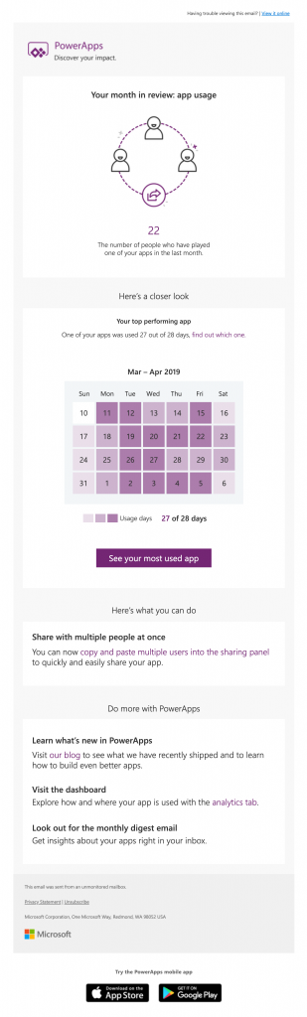
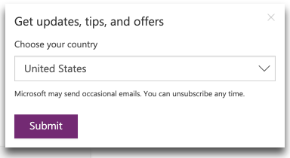
Maker self-service app updates
Power Automate maker reports
Usage (total flow runs by day, number of runs, trends) – helpful for monitoring Microsoft Flow consumption
Errors (by day, error types, error details) – helpful for troubleshooting Power Automate flows running in your environment.
Power Apps maker reports
Usage – monitor user adoption
App Performance – monitor perf by device and location
Location – helpful for executive rollups
New proactive app email updates
E-mail with usage info for their top performing apps
Includes recommendations on how to make improvements using new features
Notes:
By dec/jan 2018 - what are the connections in use for my flows; and data for approvals.

Slide 25
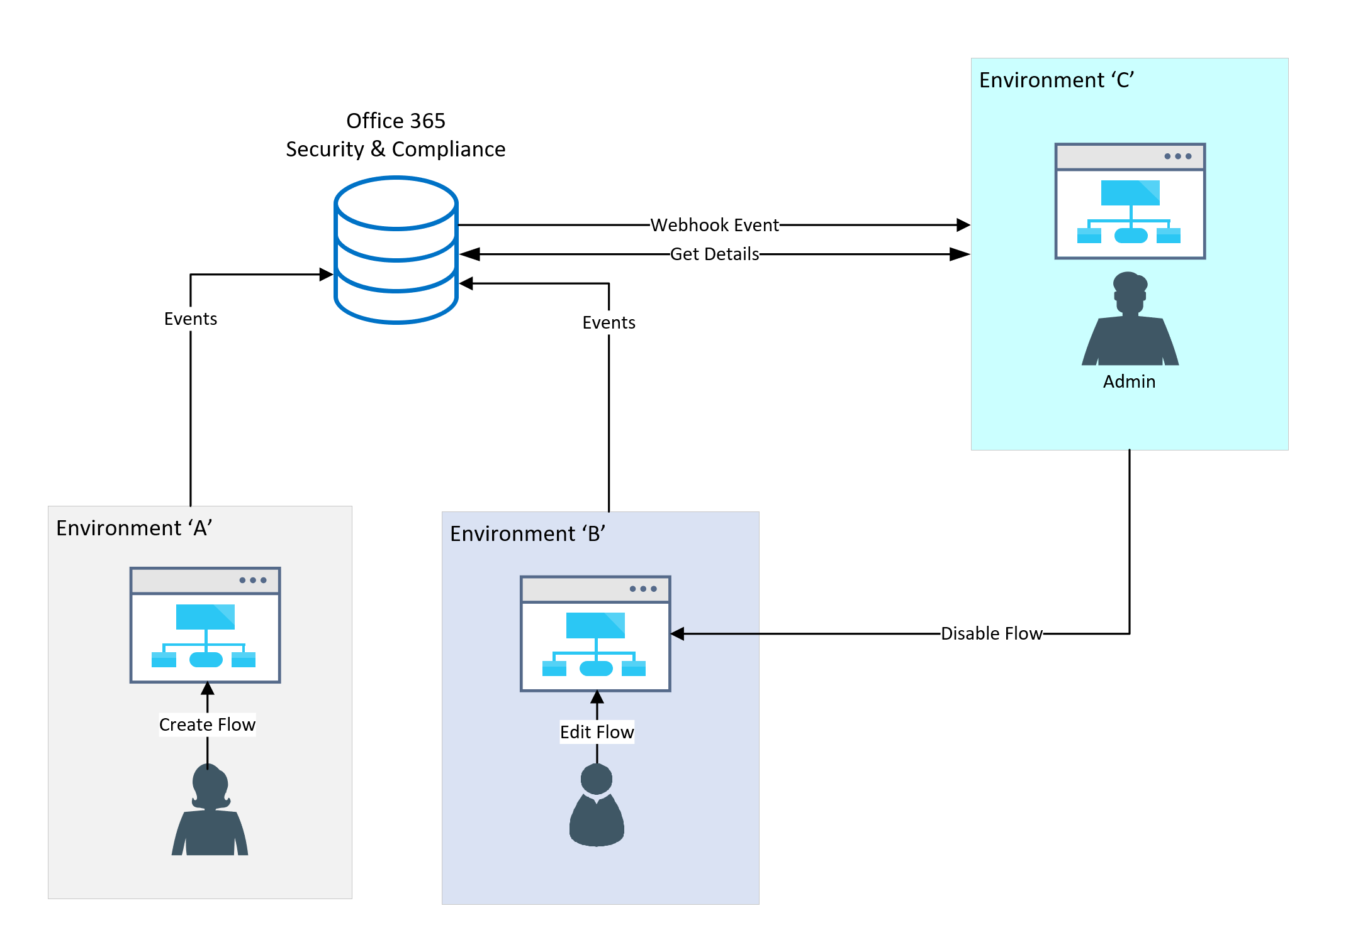
Configure audit logs
Audit log data allows looking at activity that occurred in the platform
Office 365 Activity Logging
CDS Data Activity Logging
Notes:
There are two types of audit logging that can be used to monitor activity in the platform. Office 365 activity logging can be enabled to monitor activity such as creating resources and using resources like flows or canvas apps. This can be used with out CDS being in an environment. CDS audit can be configured to monitor user usage and modification of CDS entities.

Slide 26
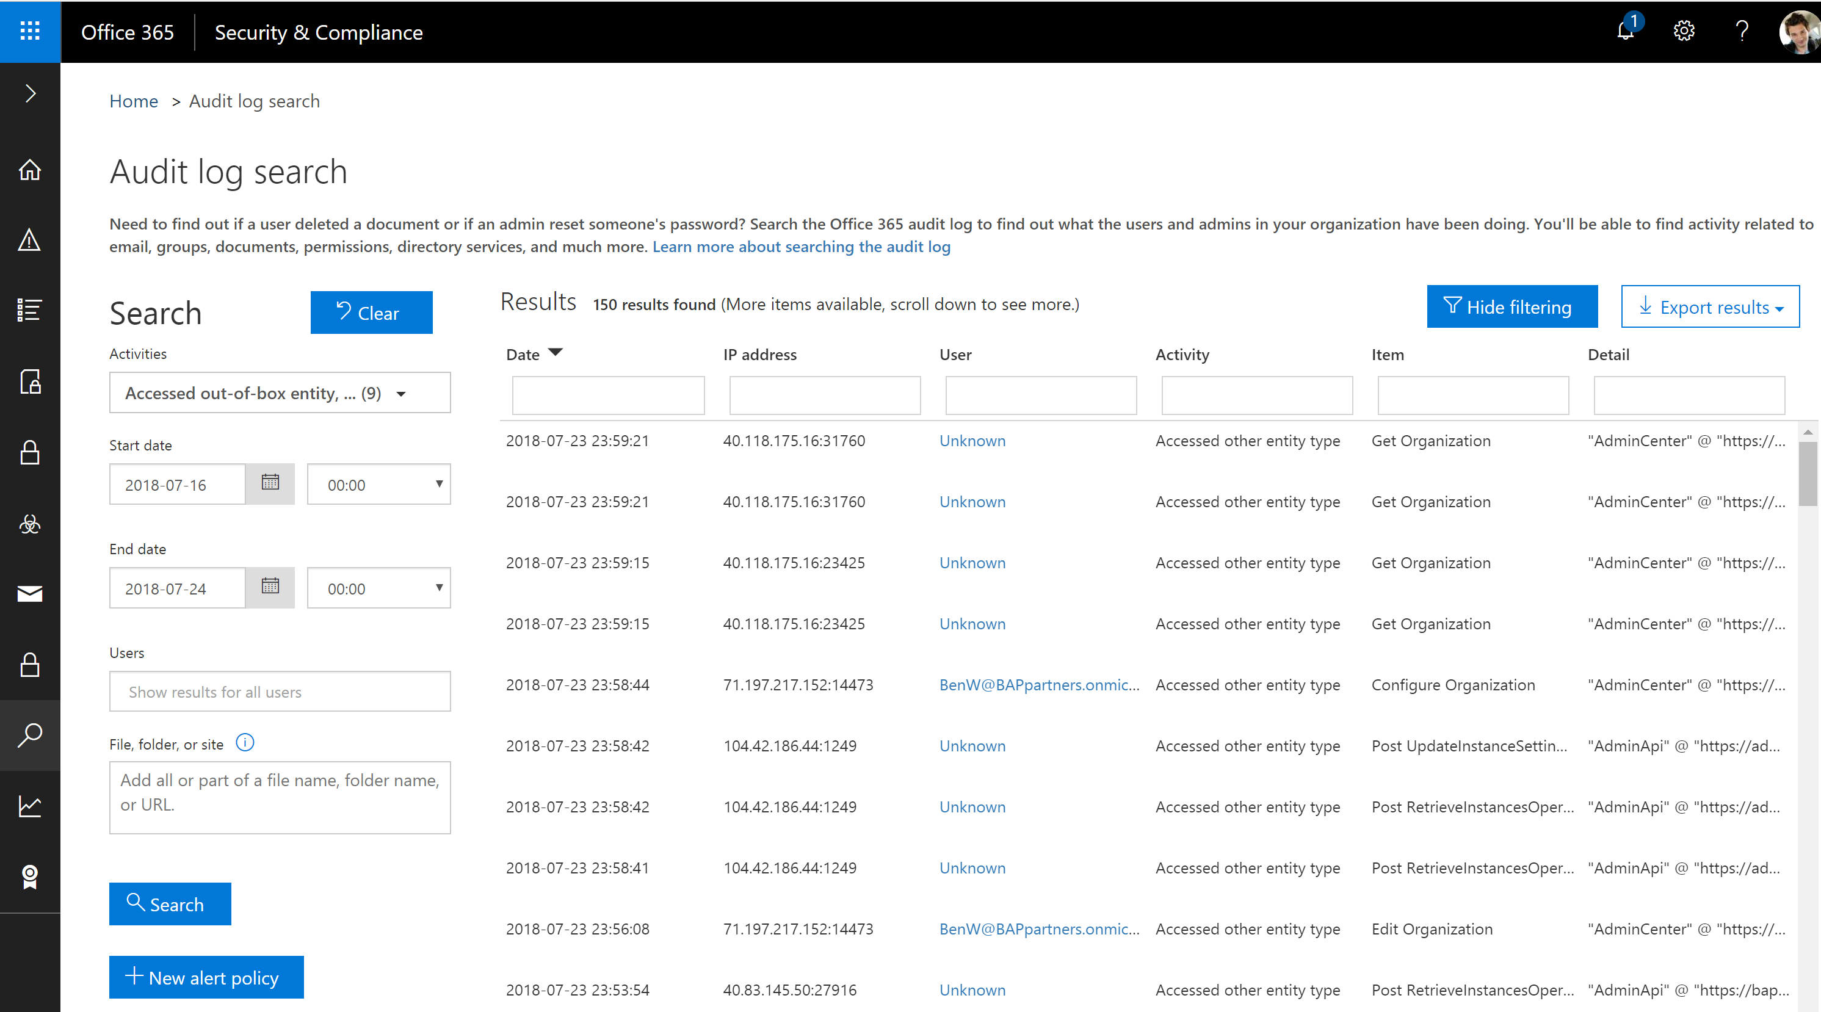
Office 365 Activity Logging
Activity Logging integrated with Office Security and Compliance center for comprehensive logging across Microsoft services
The audit records are stored in Office 365 Security and Compliance center.
Office provides an API to query this data, which is currently used by many SIEM vendors to use the Activity Logging data for reporting
Notes:
SIEM – Security Information and Event Management

Slide 27
Which activity logs are supported?
Power Automate | Power Apps
Created flow Edited flow Deleted flow Edited permissions Deleted permissions Started a paid trial Renewed a paid trial | Created app Edited/save app (draft) Published app Deleted app Restored an app from app version Launched app Marking app as featured Marking app as hero Edited app permissions Deleted app permissions

Slide 28
Enable Office 365 activity logging
Must have an Office 365 E3 or greater license
Must enable at the organization level
Enable-OrganizationCustomization
Set-AdminAuditLogConfig -UnifiedAuditLogIngestionEnabled $true
Non service admins need permissions to view
E.g. Add-RoleGroupMember "Compliance Management" -Member user1
Notes:
https://docs.microsoft.com/en-us/office365/securitycompliance/turn-audit-log-search-on-or-off

Slide 29

Build flows to alert on key audit events
An example of alerting that can be implemented is subscribing to Office 365 Security and Compliance Audit Logs
This can be achieved through either a webhook subscription or polling approach. However, by attaching Flow to these alerts, we can provide administrators with more than just email alerts
Activity Logging Web Svc
Power Apps logs
Power Automate logs
Admin
Power Automate

Slide 30
CDS Auditing
Three level configuration
All custom and most customizable entities can be audited
1. Environment
2. Entity
3. Field
Notes:
You enable or disable auditing at the environment level by setting in the admin portal on the environment. However, for entities and attributes, you set a property value of the entity or attribute metadata.

Slide 31
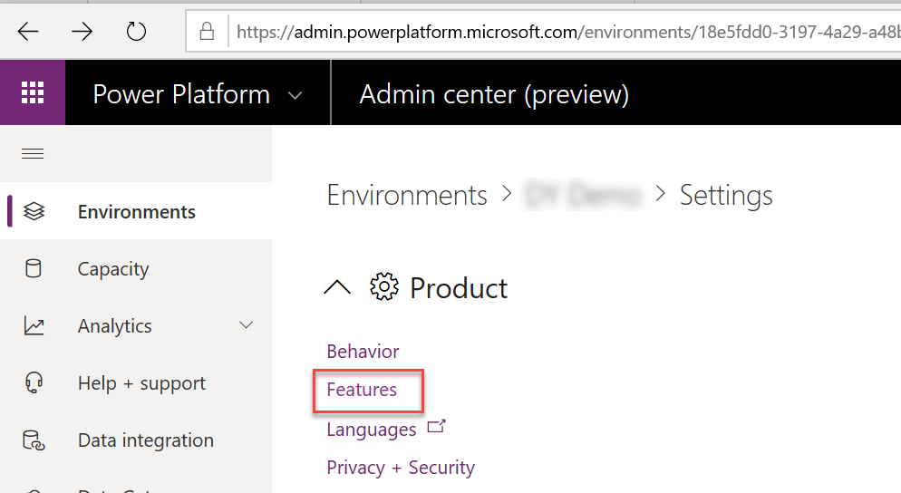
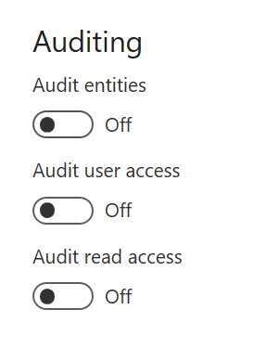
Enable CDS auditing for the environment
Notes:
Audit entities enables tracking of modifications to entity data to be tracked, this data is viewed in the context of the record in CDS
Audit user access and read access logs the data and it shows up in the Office 365 Security and Compliance center with other activity.

Slide 32
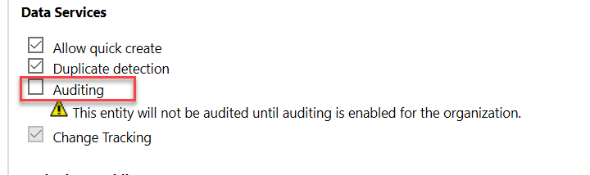
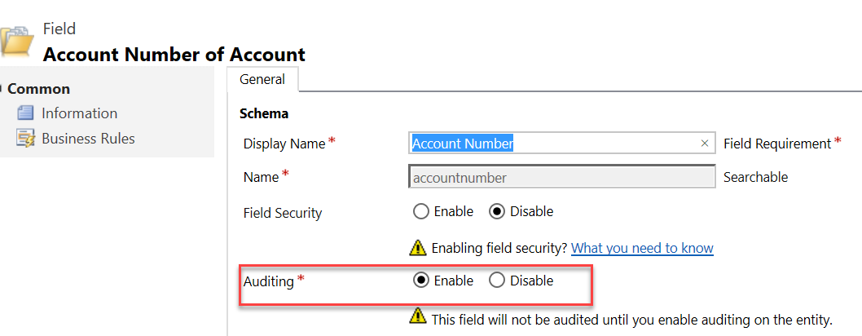
Enable for Entity and Field
Entity Level
Field Level
Notes:
This must be done on classic solution explorer

Slide 33




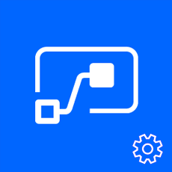
Leverage management connectors & PowerShell
powerful reporting tools + tools for action
Management connectors
Full visibility: Power Platform APIs in an accessible connector interface, provide admin access to resources
Customization : Pull the metadata you need to build the custom reports you want
Flexibility: Build the policies you need to implement administration + governance requirements
PowerApps for Admins
PowerApps for App Makers
Power Platform for Admins
Microsoft.PowerApps. Administration.PowerShell
Flow Management
Microsoft.PowerApps.PowerShell
The PowerShell Cmdlets give admins full visibility to all activity for Power Apps and Flow in their organization - aka.ms/powerappspowershell.

Slide 34
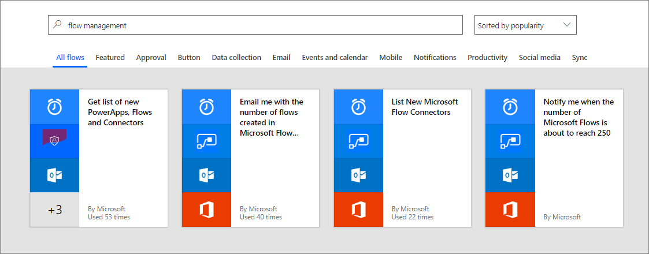
Examples of pulling ongoing reports of activity
PowerShell - https://aka.ms/downloadassetsscript
Management connectors: via Power Automate https://aka.ms/listpoweractivity

Slide 35
What about planned & unplanned platform changes/incidents?

Slide 36
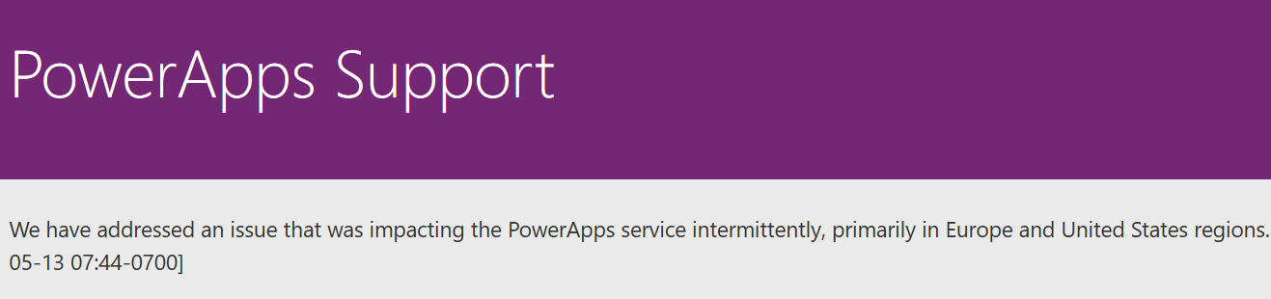
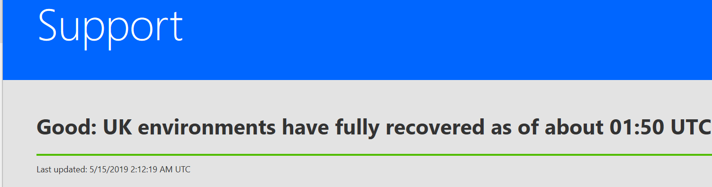
Monitoring platform status and updates
Power Apps Support
powerapps.microsoft.com/en-us/support/
Power Automate Support
flow.microsoft.com/en-us/support/
Service Health Dashboard and Message Center
Work done to maintain, and update Dynamics 365 services are communicated here, non-dynamics Power Apps and Power Automate messages will be here in the future

Slide 37
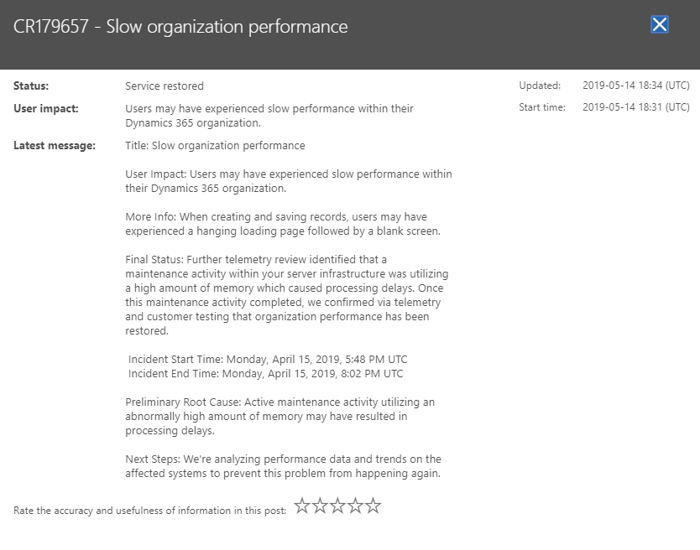
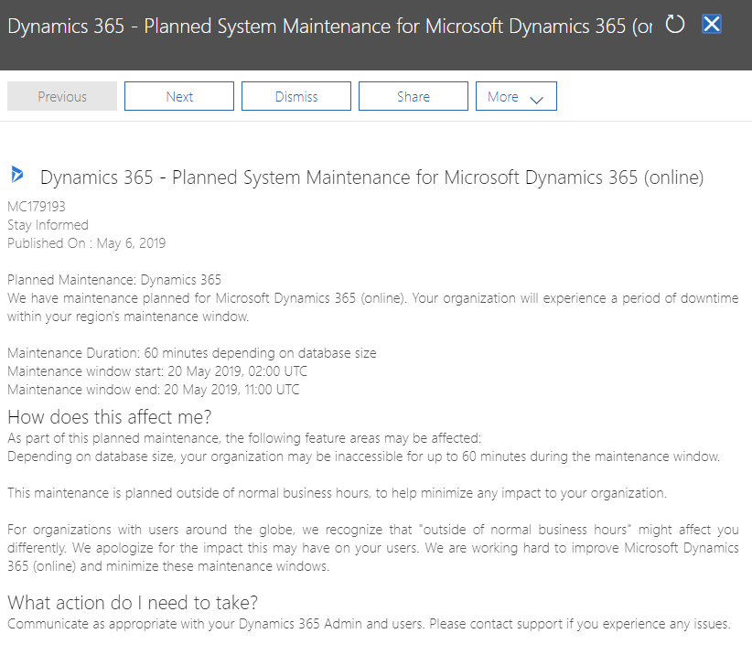
Service Health Dashboard & Message Center
Service Health Dashboard – Service Restored
Microsoft regularly communicates work done to maintain and update Dynamics 365 services to ensure security, performance, and availability, and to provide new features and functionality.
Microsoft also communicates details of service incidents including the potential user experience, the start and end time of the incident, and any workaround that may be available..
The Service health dashboard is used to communicate service incident information throughout the duration of the event. This would include the following issue statuses:
Investigating – Microsoft is investigating an event to determine the customer impact.
Service Degradation/Service Interruption- Microsoft has confirmed services are being impacted and is taking immediate action to understand the failure and steps required to restore service.
Restoring Service - Cause of the incident has been identified and mitigation steps are in progress.
Extended Recovery - Services are restored but may be slower than usual.
False Positive - Microsoft has confirmed that there was no customer impact
The Message center is used for Proactive communications to inform our customers of any of the following scenarios:
Deployments (Releases)
Maintenance
Customer Action Needed
Monthly Updates
Service Changes
Deprecation of Functionality
Message Center – Maintenance
Notes:
For each of these activities, communication is provided through the Microsoft 365 Admin center through the Message Center, and the Service health dashboard

Slide 38
Module Review
Analytics are helpful to monitor on-going activity and perform capacity planning
Activity auditing allows monitoring of what has happened in an environment
Working with makers ensures you are collecting necessary audit data
Notes:
Start Time xx:xx / Length: 2 minutes
Review the objectives for this module.
Ask participants to use the Text tool to write on the screen if they had any questions about the module.

Slide 40
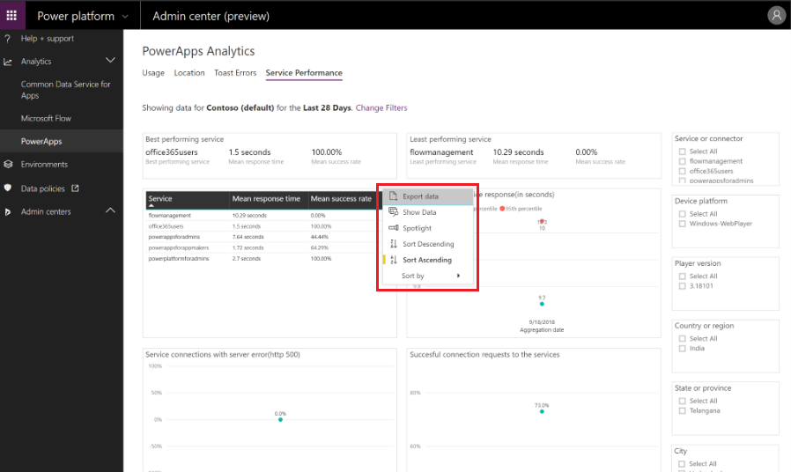
Downloading analytic data

Slide 41
Understanding storage capacity
New
Old
Storage capacity management
Database Capacity
Store and manage entity definitions and data
Database storage
File Capacity
Manage attachments, files, photos and videos
Log capacity
Record data changes over time for analysis & reporting purposes
Notes:
New customers will be under new capacity model- existing customers won’t switch until

Slide 42
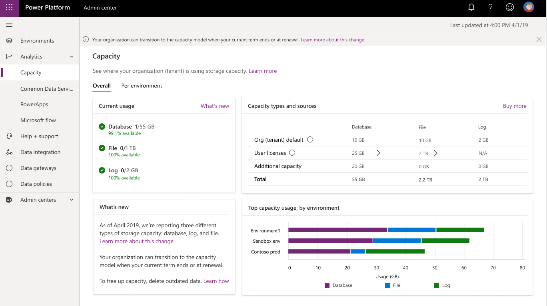
Capacity Report

Slide 43
What we plan to cover
Analytics – see what’s happening
Auditing – drill into details of what’s happened

Slide 44
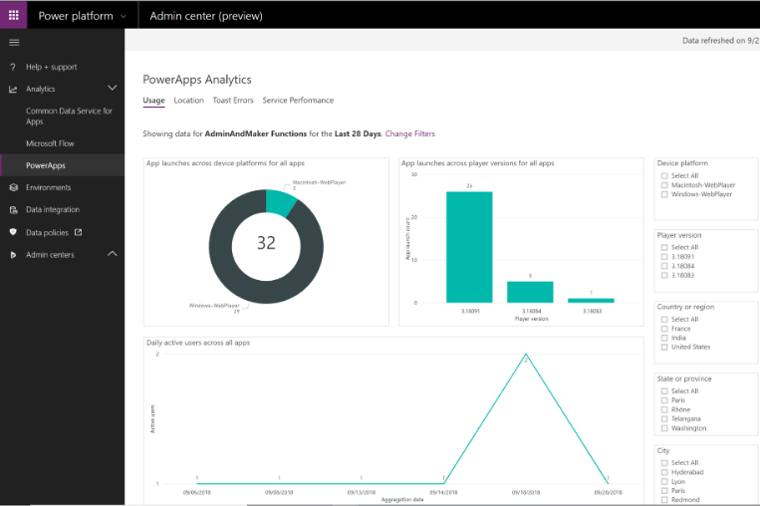
Power Apps Analytics
Usage
Location
Toast Errors
Service Performance
Notes:
Usage can provide insight into how much the app is used and when. Additional analytics can be found in the maker portal if the app is shared with you
Location can give insight into where the app is used from
Toast errors can give insight into errors users might be seeing. If users report problems with an app but don’t have specifics that is a good place to look to see if there are any errors occurring
Service performance gives insights into the performance of each connector - for example users reporting the app is slow – check here to see the performance of each connector the app uses and look for one with high average times

Slide 45
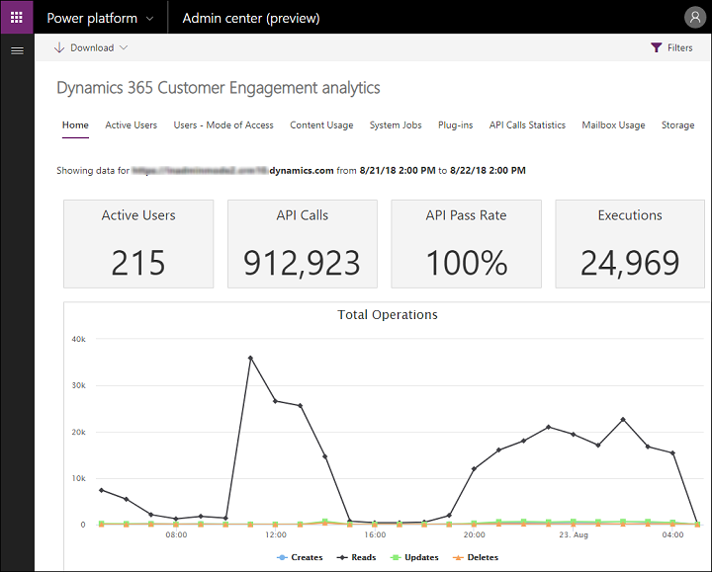
CDS Analytics
Active users
Mode of access
Content usage
System jobs
Plug-ins
API calls
Mailbox usage
Notes:
Details on definitions of chart elements can be found here https://docs.microsoft.com/en-us/power-platform/admin/analytics-common-data-service
Use this to understand your CDS workload
Active users can help understand peak times of the day and what your active user base is, it can also help you understand your mix of modifications vs read activity
Plug-ins and API Calls can be helpful to share with your development team to understand how their extensions impact the environment

Slide 46
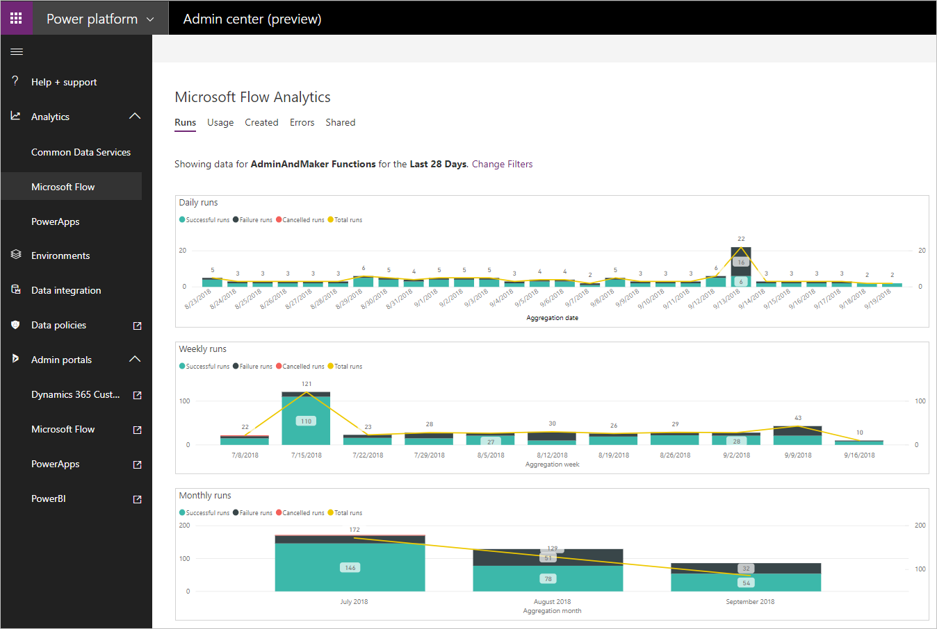
Power Automate Analytics
Usage
Created
Errors
Shared
Notes:
Usage provides insights related to the types of flows that are in use. This includes Button, Scheduled and System Event flows, all broken down by the number of runs and the trend over a configured timeline.
Created provides insight into the different types of flows that have been created. This includes Button, Scheduled and System Event flows, all broken down by the number of runs and a trend over a configured timeline.
Errors provides insights into flows that may be experiencing issues. The errors will be broken down by error type so that you can look for common problems that may exist. This can kick off the discussion with the maker so they can look at the detail for the flow.
Shared provides insight into the flows that have been shared within an environment. Include information will be the type of flow including Button, Scheduled or System Events.

